Slide 1
Understanding and Dealing With Low Back Ache. Description, How to diagnose, Pathogenesis and Pathology.
Vasu Pai, MCh, FRACS, MS[orth]

Slide 2
Prevalence
Low back ache [LBA] II to upper respiratory illness as a cause for visiting a GP
70% Have low back symptoms
75% Acute LBA are back to work within 1 month
5% Are disabled for more than 6 months.

Slide 3
5% Who are disabled for more than 6 months
Prolonged disability tend to correlate Advancing age : Not always Job dissatisfaction : Most often Psychosocial issues : Always Presence of a worker's compensation claim : Always
Definite pathology should be ruled out
Investigate

Slide 4
Spino-thalamic tract
Used to be called mental [in your head]
CRPS: we do not know the pathology
Frustrating for patients
Assessors
Csae managers
allllllllllllllssssssssssssssssssssssssssssssssssssssaaaaaaaaaaaaaaaaaaaaaaaaaaaaaaaa
allllllllllllllssssssssssssssssssssssssssssssssssssssaaaaaaaaaaaaaaaaaaaaaaaaaaaaaaaa
Spinothalamic tract
allllllllllllllssssssssssssssssssssssssssssssssssssssaaaaaaaaaaaaaaaaaaaaaaaaaaaaaaaa

Slide 5
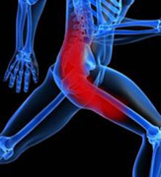
LBA: Terms
Referred Pain
Radiating Pain: Sciatic pain
Acute or Chronic
Acute LBA <3M
Chronic LBP >3 M
Acute Low Back Pain
Acute spine pain is very common Spontaneous recovery 90%.
Prolonged inactivity will prolong recovery.
Treatment regimens tend to be nonspecific.
Patient education is important Minimize the risk of recurrence.

Slide 6
Type pain
a. Neuropathic back pain is caused by damage to the central nervous system.
Disc herniation with pressure on the nerve root
Epidural scarring
Spinal tumors
b. Nociceptive pain is pain arising from damage to tissues other than nerve fibers. It is also called tissue pain.
The undamaged nerve cells called nociceptors carry the sensation to spinal cord from where it is relayed to the brain.
It is called somatic pain if it results from injury to muscles, tendons and ligaments. Somatic pain is usually well localized.
c. Visceral pain if it results from injury to the internal organs like stomach, gall bladder and urinary bladder. Visceral pain is usually diffuse and non-localizing.
d. Somatic pain in turn is classified in to cutaneous somatic pain if the pain arises from the skin and deep somatic pain if it is from deeper musculoskeletal tissues. The various causes of joint pain are grouped under musculoskeletal pain.

Slide 7
Breakthrough pain:
When pre-existing chronic pain is aggravated, it results in breakthrough pain needing adjustments in treatment to obtain relief.
In other words, breakthrough pain is the pain that results from the worsening of the previously present chronic pain for which the person is on regular treatment.
It usually comes on quickly and may last from a few minutes to an hour. The reason for this worsening of pain cannot be understood or anticipated by the person.
The routine doses of analgesic never help and a readjustment of the analgesic doses is necessary along with the modification of the physical activities.

Slide 8
Back ache
15-20% of Americans have at least one episode of back pain per year.
Most expensive cause of work-related disability in the United States.
Sex Equally.
The onset most frequent 30-50 years.
Of these patients, only 20% a precise pathoanatomic diagnosis.
80% no structural diagnosis: strain, sprain, annular tear, bulge: Balance of probabilities.
Smokers appear to have an increased incidence of back pain

Slide 9
Low back pain
I Mechanical
II Non-mechanical, specific
1. Discogenic
2. Degenerative Facetal joint arthritis
3. Instability
4. Failed back surgery
5. Osteoporotic fracture
6. Spondylolysis/Listhesis
1. Infection
2. Tumor
3. Inflammation
III: Non-mechanical and non-specific
1.CRPS
2.Non-specific pain

Slide 10
Diagnosis

Slide 11
I Discogenic
3 types Localised back pain: Sudden onset: Acute pain Spasm, relieves with rest More on sitting/bending
BA + Buttock or back of the pain: referred pain
Sciatica: along nerve root : “radiating”

Slide 12
Discogenic pain
AF: Outer Type I & II collagen
NP: Type II collagen
Disc: 90% water [With age= less water] KSO₄/CSO₄ is more
Kirkaldy Willis:
Stage I: 15-40 yrs disc dysfunction
StageII: 40-6
Spinal instability
Stage III: >6
Spinal stabilisation

Slide 14
Disc Herniation
L5 radiculopathy is the most common;
S1 radiculopathy is the next most common,
L3 to L4 radiculopathy.
Thoracic disc is very rare; <1%

Slide 15
Radiculopathy
Usually associated with neurologic signs or symptoms
MRI evidence of spinal nerve root compression
Disk herniation through the annulus fibrosis does not in itself produce pain, but compression by disk of the dural lining around the spinal nerve root sleeve is one likely explanation for the back pain associated with acute disk herniation.
Compression may directly stretch nociceptors in dura or nerve root sleeve Ischemia from compression of vascular structures chemical reaction

Slide 16
Types of Disc Rupture
Types:
I Annular Bulge: Circuferential
II Disc Protrusions [Annulus fibrosus is still intact
III. Extruded [Out of annulus but in continuity]
IV. Sequestered [not continuous with the disc]
V Far out disc
VI Annular tear
Bulge
Protrusion
Extrusion
Sequestrated
Central
Postero-central
Foraminal
Extraforaminal

Slide 17
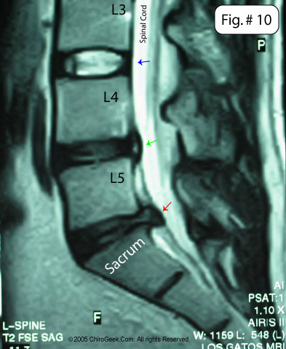
Types of disc lesions
L5/S1 disc extrusion
L4/5 disc protrusion
L3/4 Normal
L4/5 & L5/S1 "black“ desiccation

Slide 18
Treatment for disc herniation
Likely to have significant spontaneous recovery.
Reliable outcome studies Medical versus surgical treatment ; are not available.
The risk is clearly greater in this group for progression of the neurologic deficits and residual neurologic impairment if spinal nerve root compression persists.
Cauda equina compression.
Prolonged inactivity is not beneficial, and mobilization should be encouraged as soon as symptoms stabilize.

Slide 19
Chronic Nonspecific Back Pain
Physical therapy. By 3 to 4 weeks after onset of symptoms
,
An aggressive program of mobilization, postural improvement, and increased endurance.
Yoga techniques provide useful stretching maneuvers
In the treatment of subacute and chronic spine pain, osteopathic physicians and chiropractors provide spinal manipulation techniques,
At 12 weeks, there was no significant difference in the degree of improvement between the Physio and chiropractor. More than 90% of the patients in both groups were satisfied with their care.
Transcutaneous electrical nerve stimulation: varying results.
Corticosteroid injections in facet joints and epidural locations: The value of therapeutic corticosteroid injection in the setting of chronic nonspecific back pain without established radiculopathy has not been proved.

Slide 20
Chronic Lumbosacral Radiculopathy
When the manifestations of radiculopathy are primarily sensory or when the motor deficits are stable
Epidural Corticosteroid Injection
A randomized, double-blind trial performed by Carette 158 patients with lumbar radiculopathy of 4 to 52 weeks duration [such patients with CT evidence of disk herniation)
Six weeks after three epidural injections of either corticosteroids or saline, patients who had received corticosteroids had somewhat more improvement in leg pain—but at 3 months there was no significant difference between the two groups.
Twenty-five percent of patients in both groups eventually went on to lumbar spine surgery.

Slide 21
Degeneration

Slide 22
Prevalence of degenerative in Young MRI
The prevalences of disc bulges and radial tears were 25% and 9.1%
Herniations were significantly more common among men
More common at the L5-S1 level
The prevalence of the Modic changes was 1.4%
CONCLUSION: Almost half of young Finnish adult aged 21 years had at least one degenerated disc, and a quarter had a bulging disc.
Spine (Phila Pa 1976). 2009 Jul 15;34(16):1716-21.

Slide 23
Spinal stenosis

Slide 24
Synovial cyst

Slide 25
Pathology
Lumbar disc: rupture/Degenerate
Ruptured/Degenerated disc can dessicate
These desiccated disc cannot perform load bearing function
Leading to spinal instability.
Increased Stress 0n the facetal joint
Facetal Osteo-arthritis Asymptomatic ➔ Symptomatic

Slide 26
Normal Vs Spinal stenosis

Slide 27
Spinal Instability
Slippage of the fourth lumbar vertebra (L4) over the fifth lumbar
Approximately 80% of patients evaluated for degenerative spondylolisthesis
Is caused by degenerative changes of the disc
tri-joint complex) with secondary weakening of ligamentous restraints. These anatomic entities contribute important stability and unity

Slide 28
III Failed back

Slide 29
Recurrent disc
Defined recurrence as symptom recurrence after a pain-free interval > 6 M
MRI with gadolinium –ve
The recurrence rate rises steadily with time until 9 years after surgery in our series;
It was 2.8% in patients followed at 1 year, 6.2% at 5
years, and 8.5% at 9 years

Slide 30
Epidural scaring: Enhances on Gad
Epi fibrosis is unavoidable adverse effect of lumbar disc surgery.
Epi fibrosis is responsible for as much as 25% of all Failed Back Surgery Syndrome.
A recently published study found that patients with extensive epidural fibrosis were 3.2 times more likely to experience recurrent radicular pain than those with less extensive scarring.

Slide 31
Adjacent disc degeneration
Symptomatic adjacent-segment disease occurred at a relatively constant incidence of 2.9 percent per year (range, 0.0 to 4.8 percent per year) during the ten years after the operation.
25% at 10 years
preexisting radiographic evidence of degeneration at adjacent levels appear to be the greatest risk factors

Slide 32
Pseudarthrosis
Pseudarthrosis is still one of the most difficult conditions to assess as a source of symptoms, and not surprisingly the outcome from repair of pseudarthrosis is the most difficult to predict.
More definitive evaluation of pseudarthrosis usually requires CT with two-dimensional and possibly three-dimensional reconstruction.
Adjacent levels and the status of neural structures may be evaluated via MRI scanning, discography, and myelography.
The use of posterior instrumentation in light of an anterior pseudarthrosis or anterior support in light of a posterior pseudarthrosis is a viable option
BMP

Slide 33
OA after Discectomy
Eur Spine J. 2010 Jan;19(1):136-43.
Retrospective controlled study 21 years follow up
50 patients who had undergone discectomy for lumbar disc herniation.
Moderate to severe radiographic changes were present in (90%) and 34 controls (68%), respectively (P = 0.013).
The most prevalent changes were loss of disc height (89%), facet joint arthritis (89%), and endplate changes (57%).
In conclusion, standard lumbar discectomy frequently leads to long-term degenerative changes on imaging tests.

Slide 34
Lumbar fractures
1. Easy to diagnose on Plain X ray
2. Sometimes: CT/MRI/Bone scan
3. Beware congenital/lumbar Scheurman’s/Pathological fracture/Spondylosis
4. Osteoporotic fracture or insufficiency fracture

Slide 35
Treatment for burst fracture
Generalized treatment algorithms for burst fractures involving upper lumbar spine have relative indications for surgery that include 50% loss of height, 25% of kyphosis, and 50% canal compromise.
Absolute indications for decompression include neurological deficits including a potential conus injury.

Slide 36
Osteoporotic fracture

Slide 37
Comparative Incidence of Chronic Diseases
2000
1 500 000¹
1500
Annual Incidence in the US x 1000
1000
500 000²
500
240 000³
180 000³
0
Osteoporotic
Fractures
Heart
MI
Stroke
Breast
Cancer
¹Osteoporosis Fast Facts. National Osteoporosis Foundation. 2000. ² National Institutes of Health. Healthy Heart Handbook for Women. 2000.
Notes:
The incidence of osteoporotic fracture in women is far greater than the incidence of heart attack, stroke, and breast cancer combined. Yet, osteoporosis remains largely underdiagnosed and undertreated. Although patients are routinely screened for risks factors associated with heart attack, stroke, and breast cancer, prevention and treatment of osteoporosis is often overlooked.
In the United States alone, only one third of vertebral deformities are clinically diagnosed, a clear indication that the incidence of vertebral fracture remains underestimated (Cooper C, Melton LJ, 1992.).
Cooper C, Melton LJ. Epidemiology of Osteoporosis. Trends Endocrinol Metab. 1992;3:224-229.
Osteoporosis Fast Facts. National Osteoporosis Foundation. Available at: http//www.nof.org/osteoporosis/stats.htm. Accessed November 8, 2000.
National Institutes of Health, National Heart, Lung and Blood Institute. Healthy Heart Handbook for Women. Available at: http://www.nhlbi.nih.gov/head/public/heart/other/hhw/index.htm. Accessed November 9, 2000.
Statistical Information on Women and Women’s Health. The National Women’s Health Information Center, US Department of Health and Human Services Available at: http://www.4woman.gov/media/statistics.htm. Accessed November 9, 2000.

Slide 39
Osteoporosis
1.Osteoporosis: with each S.D on DEXA scan
Overall # risk 1.5
Hip # 2.3
Spine # 2.6
2. Vertebral Pseudarthrosis and Kyphoplasaty or vertebroplasty
3. Vertebroplasty/Kyphoplasty: 90% good results
30% canal leak of the cement
3% interactable pain
.

Slide 41
*Pseudarthrosis of vertebra in the osteoporotic spine: JBJS 79B: 452
Elderly - vertebral collapse
Flexion and extension: Vertebral vacuum sign
-MRI: Fluid in the vertebra
Treatment
1. -Retroperitoneal approach and tricorticate graft.
-No fixation necessary
2. Vertebroplasty/Kyphoplasty
Prognosis
-Good pain relief

Slide 42
Osteoporotic spinal fractures
Life time risk of hip fractures: 17% in women
[> 50 yrs] 6% in men
Vertebral fractures: 25% in women
Presence of one fracture: II fracture is 10 fold higher
Osteoporosis: with each S.D
Overall # risk 1.5
Hip # 2.3
Spine # 2.6

Slide 43
C/F
Acute pain and in 2/3 rd settles in couple of months.
1/3: Persistent pain
Loss of body height and kyphosis
Vertebral pseudarthrosis: Lateral veiw with flexion and extension (serous fluid and fibnrous and fibrocartilaginous at pseudarthrosis)= Alligator mouth phenomenon (MRI= cleft is visualised)
Rarely neurology

Slide 44
For cement
Patient Eligibility
The distribution of nonunion vertebral fracture painful vertebrae was: 2 in T11, 6 in T12, 10 in L1, and 3 in L2.
Preoperative bone density testing showed differing degrees of osteoporosis, with the average being 0.672 g/cm².
The criteria for diagnosis of nonunion
1) history of pain of at least 6 months at the fracture site;
2) low T1 and high T2 signal on MRI;
3) widening of fracture line on routine radiographs;
4) movement of the endplate and changes of anterior vertebral heights on hyperextension radiographs

Slide 45
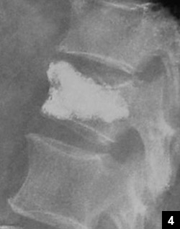
Pseudarthrosis

Slide 46
Lysis/Listhesis

Slide 47
Spondylolisthesis
Spondylolysis/ spondylolisthesis are often diagnosed in children presenting with low back pain.
Isthmic spondylolysis, isthmic spondylolisthesis, and stress reactions involving the pars interarticularis
Typical presentation is characterized by a history of activity-related low back pain
Spondylolysis often responds to brief periods of activity restriction, immobilization, and physiotherapy.
Low-grade spondylolisthesis (50% translation) is treated similarly.

Slide 48
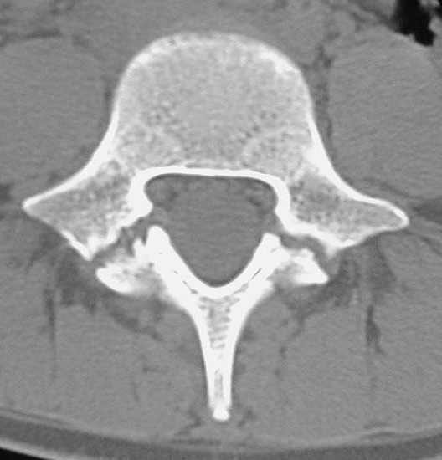
Stress reaction
Stress #
Lytic defect

Slide 49
Etio
1. Congenital: rare. No evidence of lytic defect in the newborn
2. More in athlete: Mechanical stress = Acute or stress
3. Stress: During flexion and extension: compression and tensile force
4. Once defect created, the biomechanical forces prevent healing of the fracture ➔ listhesis due to shear forces created by the center
5. Genetic : Autosomal dominant with incomplete penetration
6. Dysplastic : lack of lumbosacral facet joint may not withstand even normal daily activities

Slide 50
Natural History
Overall incidence: listhesis/Lysis: 16%
Female Gymnasts 10-20%
Alaskan population 50%
African 1.8%
Caucasian 5.6%
Unilateral 20%

Slide 51
Natural History
Progression of spondylolysis and low-grade listhesis: < 5% during growth spurt
Progression is rare in adults: usually due to disc degeneration
When progression does occur, high-grade spondylolisthesis is rare.
Adults with spondylolysis have no more back pain than the general population [10%]
Dysplastic more frequent neurological symptoms and progression of deformity.
High-grade spondylolisthesis, regardless of etiology, is an uncommon primary
diagnosis.
Although some individuals have only limited disability in adulthood, many patients with high-grade spondylolisthesis develop pain, neurologic symptoms and progressive deformity.

Slide 52
Diagnosis
Plain radiograph:
Standing: AP,Lateral, Obliques
Dysplastic or Isthamic depending on shape of the sacrum or vertebra
Scottish terrier: with the defect in the dog’s neck
Listhesis: Grade
Slip angle
Sacral inclination
Lordosis

Slide 53
Back strain
20 to 40
Pain: Low back, buttock, posterior thigh Ache, spasm
Aggravation: Increased with activity or bending Local tenderness, limited spinal motion
Negative investigation

Slide 54
NON ORGANIC OR FUNCTIONAL

Slide 55
Nonspecific Back pain
The pain is localized to the spine and/or paraspinal regions and does not radiate into the leg.
Not associated with spinal nerve root compression.
Normal magnetic resonance imaging (MRI)
Is often a result of simple soft tissue disorders such as strain
Does not need specialist treatment

Slide 56
Organic or Functional

Slide 57
Treatment
Conservative medical management. Abstain from heavy lifting or other activities that aggravate the pain. Bed rest is not helpful, and has been shown to delay recovery. Narcotic analgesia should be avoided
Cherkin Standard physical therapy maneuvers
Chiropractic spinal manipulation The treatment of acute low back pain and found that both provide small short-term benefits and improve patient satisfaction but increase the cost of medical care and do not decrease the recurrence of back pain.

Slide 58
Complex Regional Pain Syndrome I:
Complex Regional Pain syndrome I also called as Reflex Sympathetic Dystrophy is a continuous pain in the form of either allodynia or hyperalgesia in the extremities resulting from trauma which is associated with sympathetic hyperactivity.
The pain does not correspond to the distribution of a single nerve and it is worsened by movement. The person affected usually complains of cool, clammy skin which later becomes pale, cold, stiff and atrophied.
Complex Regional Pain Syndrome II:
Complex Regional Pain Syndrome II also called as Causalgia is a burning type of pain along the distribution a partially damaged peripheral nerve. The pain extends beyond the distribution of the nerve. This results from abnormal connections between various nerves. The skin of the person affected is classically cold, moist and swollen, becoming atrophic later

Slide 59
Psychogenic pain:
Psychogenic pain is seen in persons with psychological disorders.
They have persistent pain without any evidence of physical cause of pain.
Though it is termed psychogenic the person suffers from real pain.
This pain is also called chronic pain syndrome.
Sometimes psychogenic factors may worsen a pre-existing physical pain.
Anesthesia dolorosa:
Anesthesia dolorosa is the pain that is felt in the part of the body that is numb to any other sensation.

Slide 60
Musculoskeletal pain syndromes
Musculoskeletal pain syndromes that produce low back pain include myofascial pain syndromes and fibromyalgia.
Myofascial pain is characterized by pain and tenderness over localized areas (trigger points), loss of range of motion in the involved muscle group
Fibromyalgia results in pain and tenderness on palpation of 11 of 18 trigger points, one of which is the low back area, as classified by the American College of Rheumatology. Generalized stiffness, fatigue, and muscle ache are reported.

Slide 62
Pathophysiology
Its nonspecific etiology.
Pain may arise from a number of sites, including the vertebral column, surrounding muscles, tendons, ligaments, and fascia. No tool to quantify
Stretching, tearing, or contusion of these tissues may occur after sudden unexpected force injury events such as heavy lifting, torsion of the spine, and whiplash injury.
Whether muscle spasm is a significant etiology of lumbar spine pain, either as cause or effect of back injury has not been proved.

Slide 63
Beware: Cx spine case

Slide 64
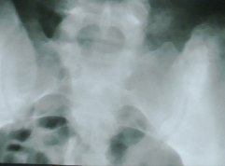
EWINGS SARCOMA - PERMEATIVE APPEARANCE OF
POSTERIOR ILIUM

Slide 65
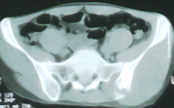
EWINGS SARCOMA (ILIUM) WITH SOFT TISSUE EXTENSION
CT : Destruction of the ILIUM adjacent to SI joint
Soft tissue mass close to ilium ? Sarcoma.

Slide 66
Beware thoracic spine > 3months

Slide 67
Return to work
60% 6 weeks
80% 8 weeks
90% 12 weeks

Slide 68
Chr Pain Syndrome: Pain modulation is defective
Used to be called mental [in your head]
CRPS: we do not know the pathology
Frustrating for patients
Assessors
Case managers Pathology do not change
Light work is good
allllllllllllllssssssssssssssssssssssssssssssssssssssaaaaaaaaaaaaaaaaaaaaaaaaaaaaaaaa
allllllllllllllssssssssssssssssssssssssssssssssssssssaaaaaaaaaaaaaaaaaaaaaaaaaaaaaaaa
Spinothalamic tract
allllllllllllllssssssssssssssssssssssssssssssssssssssaaaaaaaaaaaaaaaaaaaaaaaaaaaaaaaa

Slide 69
Non-organic signs [Waddell Signs]
1. Superficial touch. over the lumbar region to light touch
2.Nonanatomic tenderness
3. Exacerbation of pain by applying a few pounds of pressure with the hands to the top of the head
4. Exacerbation of pain by simulated rotation of the spine
5. Ability to sit up straight from a supine position, but intolerance of the straight-leg-raising test
6.Nonanatomic distribution of sensory changes
A particularly useful test is to have patients hold their wrists next to their hips and turn their body from side to side. This test gives the illusion that you are testing spinal rotation, but no actual stress is placed on any muscles or ligaments. Any complaint of pain during this maneuver is strongly suggestive of a functional overlay or component of secondary gain in the presentation

Slide 70
Pathology

Slide 71
Disc Herniation
Pathology of chronic disc herneation (annulus fibrosis)
Abnormal loading of the lumbar disc can rupture the outer layer of disc(annulus fibrosus) allowing disc material to herniate.
With time the ruptured disc can dessicate and these dessicated disc cannot perform load bearing function of the spine.
In addition the dessicated disc allows abnormal mobility leading to spinal instability. When there is any increase in loading this unstable spine can give rise to episodes of acute pain

Slide 72
Spinal stenosis
Pathology of chronic disc herneation (annulus fibrosis)
Abnormal loading of the lumbar disc can rupture the outer layer of disc(annulus fibrosus) allowing disc material to herniate.
With time the ruptured disc can dessicate and these dessicated disc cannot perform load bearing function of the spine.
In addition the dessicated disc allows abnormal mobility leading to spinal instability. When there is any increase in loading this unstable spine can give rise to episodes of acute pain
More stress on the facetal joint: facetal joint arthritis

Slide 73
INVESTIGATION

Slide 74
Xray
Routine Radiographs of the Spine: These studies are of limited value
Guidelines from the U.S. Agency: acute LBP in the following settings:
acute major trauma,
minor trauma associated with risk of osteoporosis,
risk of spinal infection,
pain that does not respond to rest or recumbency,
They may also be of value in the assessment of spinal alignment and rheumatologic disorders of bone.

Slide 75
CT/MRI
Sensitive tools for the evaluation of neural structures such as spinal nerve roots and the spinal cord
Of the two modalities, MRI resolution for neural structures is superior to CT.
In the absence of nerve deficit, and in the absence of significant trauma, infection, or malignancy, the American Academy of Neurology guideline recommends nonsurgical therapy before these techniques are used in patients with uncomplicated acute low back pain of less than 7 weeks duration.
Patients with acute neurologic deficits associated with LBP should be considered for MRI or CT of the lumbosacral spine—unless surgery and invasive therapeutic options are not indicated.

Slide 76
Electrodiagnosis
Electrodiagnostic tests (nerve conduction studies and needle electromyography [EMG]) are most useful in the presence of a motor deficit on neurologic examination.
NCS : to exclude other neuromuscular disorders that may mimic radiculopathy, such as peripheral polyneuropathy and mononeuropathies.
The H-reflex can be a useful nerve conduction study when assessing for the presence of an S1 radiculopathy.
This procedure will help distinguish weakness due to spinal nerve root damage from other causes of weakness identified on the physical examination, such as other neuromuscular disorders, central nervous system disorders, and non-neurologic causes of weakness (pain, malingering). The needle electrode examination should be performed only after at least 3 weeks have passed since the onset of weakness because fibrillation potentials (the major manifestation of acute denervation) do not reliably develop before that time.
Electrodiagnostic testing may be of value in the assessment of patients with postsurgical deficits, multisegmental neurologic deficits, or multilevel intraspinal structural changes. Such patients present with complicated clinical and neuroimaging evidence, and electrodiagnostic testing may clarify issues of the location, activity, and severity of spinal nerve root disease.

Slide 78
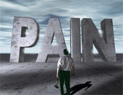

Slide 80
Thank you

Slide 81
Allodynia is a pain that results from the stimulus which does not normally evoke any pain sensation. Many people aquire allodynia after they've been in pain for quite some time and they become hypersensitive to touch.

Slide 82
Schmorl and Junghanns node
Congenital defect in the hyaline cartilage. Hyaline cartilage, Avascular structure normal suitable for weight transmission from disc.
Defect ➔ NP intrudes ➔ surrounding vascular bone becomes avascular ➔ becomes dense.
Very often seen in Scheurmans

Slide 83
Why disc replacement is indicated than arthrodesis
1. Lack of predictability of pain relief.
2. Loss of motion. Permanent elimination of motion is bad for spinal kinematics
.
3. The prevalence of failure of fusion or pseudarthrosis
4. A fourth important difficulty with lumbar arthrodesis is the lack of precision of the sagittal balance. Difficult to know what is normal balance
5. A fifth major problem is adjacent segment disease= Transition syndrome 30% at 10 yrs
6. Donor-site complications are also an important source of disability. 10%

Slide 84
To be a true alternative to spinal fusion, the goals of disc replacement should at least include those of fusion,
1. removal of the disc, assuming it to be the main source of pain
2.Restoration of disc height: good for stenosis,
segmental stability : Reduces pain
lordosis curve = rebalances the spine.
3. Preservation or improvement of segmental motion = good for transitional syndrome
The materials must be biocompatible and endure in vivo for up to 40 years.
The biomechanical properties should allow for a near-normal range of movement and function.

Slide 85
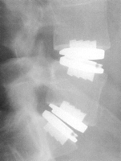
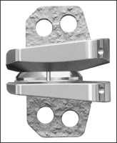
Charité III prostheses and more than 2000 ProDisc prostheses implanted there since 1987.
Artificial disc replacement is a relatively new phenomenon in the United States, and it was not until October 2000 that the first Link SB Charité disc was implanted in this country and not until October 2001 that the first ProDisc was implanted in the United States.
Link SB Charite III ProDisc device The Maverick

Slide 86
Pregnancy related back pain — Pregnancy related back pain can affect pregnant women during the late second and third trimesters. Back pain from pregnancy is often concentrated in the lumbar region, and is commonly treated with back pain exercises and other forms of natural back pain relief.

Slide 87
Kummel’s Disease CORR : 423” 297
Is rare; Preceded by trauma, usually single vertebra from T8-L4
Osteonecrosis and collapse of the vertebral body
Kummen described in 1895: 3 phases: I Injury
II Chronic Pain [6-8 months]
III Deformity due to collapse
With the advent of X ray: initial injury and radiograph = Normal
More common in Elderly patients
Histopath: AVN of vertebra
D/D: Osteoporosis, II, Myeloma, Infection.
MRI: Intravertebral vaccuum is + highly suggestive of Kummels.

Slide 88
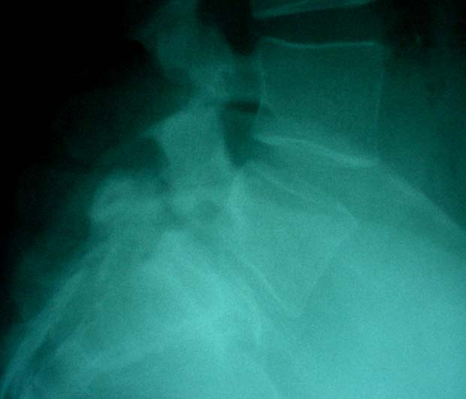

Slide 89
Methylprednisolone
NASCIS: 1997
Within 8 hrs: Loading dose of MP IV bolus 30 mg/Kg
5.4 mg/kg hourly for 24 hrs IV infusion
<3 hrs: Give for 24 hrs; 3-8 hrs = 48 hrs.
Presently: Questioned
High complication in operated group
Still useful: in Pathological lesions
Head injuries

Slide 91
Chiropractors
have been the main practitioners of spinal manipulative therapy, with
osteopaths and physical therapists providing a smaller fraction of these services.
Theories explaining the mode of action of spinal manipulative therapy are largely preliminary and have focused on the mechanical effects of manipulative forces on the spine and neurologic responses to manipulation.
The effects of spinal manipulation on patients with both acute and chronic low back pain have been investigated in randomized clinical trials.
Most reviews of these trials indicate that spinal manipulative therapy provides some short-term benefit to patients, especially with acute low back pain.

Slide 92
Spinal Manipulation
3 broad categories:
therapeutic massage, mobilization, and manipulative procedures
Massage includes manual procedures applied to the spinal soft tissues without causing joint
movement, such as deep tissue massage, acupressure, muscle stimulation,and relaxation methods.
Mobilization generally refers to procedures that exert stretching, traction, or pressure on the spine within or at the limit of active range of motion. They usually consist of passive force exerted by the clinician on the joint but may require active contraction of specific muscles by the patient to assist in the motion.
Spinal manipulation usually requires application of a quick, highvelocity, short-amplitude force, either directly or indirectly, to the spine.
Most of these techniques involve so-called short levers directed at the vertebral processes (eg, spinous, transverse, mammillary, articular) to apply force to a specific spinal segment.

Slide 93
So-called long lever techniques consist of force applied to an extremity (eg, arm, shoulder, hip, leg) to move the spine indirectly.
The movement is often accompanied by an audible sound that may be attributable to joint cavitation, 8 which is the release of tissue gas (probably nitrogen) into the joint space as the result of a vacuum created by the manipulative thrust.
Acupressure and soft-tissue massage may be done in preparation for manipulation or as the sole method of treatment.

Slide 94
Theory
1.The manipulable lesion or subluxation in chiropractic terminology) was considered a bone out of place impacting either the vascular structures or spinal nerve roots.
2.Current theories of spinal pathology that incorporate concepts of abnormal spinal biomechanics and include neurophysiologic theories about reflex function and pain physiology.
3.Unit can display abnormal motion or become fixated (ie, mobility can be restricted within the normal physiologic range of joint motion).
Spinal manipulation also is accompanied by a reflex contraction of paraspinal musculature.

Slide 95
Summary
Spinal manipulation is a common and generally safe method of lower back pain therapy.
SMT for acute and chronic back pain provides at least short-term benefits.
A high degree of acceptance of and satisfaction with such procedures. Because of this patient satisfaction
Identification of the mechanism through which manipulation affects symptoms is under
increasing investigation.

Slide 96
Facet Joint Injections
Considerable disagreement exists about the role of the facet joints
No evidence supports the use of facet injections in the management of acute low back pain.
Facet injections may provide short-term functional improvement in patients with chronic low back pain; however, their long-term efficacy and superiority has not been established.
Epidural injections of corticosteroids
The effect is believed to result from interruption of the pain by reduced inflammation induced by steroids
A.stabilize cell membranes
Multiple randomized and nonrandomized
trials have been conducted
There is weak evidence that corticosteroid injections are effective in patients with radiculopathy, and no evidence that they are effective for acute low back

Slide 99
Waddell: Non-organic
Causes for low back pain, predicting delayed recovery and suggesting the need for a multidisciplinary approach to treatment.
Historical Symptoms Suggesting Nonorganic
1. Pain at the tip of the tailbone
2.Whole-leg pain in global distribution Whole-leg numbness in a global distribution [non-radicular]
3. Sudden give-way weakness of the leg
4.Absence of even brief periods of relative pain relief
5.Failure or intolerance of numerous treatments
6. Numerous urgent care visits or hospitalizations for back pain D

Slide 100
Organic or Functional

